Slide 1

Software Engineering
Software Project Management, Architecture & Design
Software Design
Department of Computer Science and Engineering
Acknowledgement: Authors of the prescribed textbooks and materials sourced online.

Slide 2

Software Design
List of Contents
Introduction to Software Design
Design Principles
Techniques that enable design
Key Issues
Department of Computer Science and Engineering
‹#›

Slide 3

Thoughts Regarding Design
Design is a waste of time
We are judged by the amount of LOC/month
We know that the schedule is too tight
We need to show something to the customer real quick
Hence, most programmers skip requirements, architecture and design and directly start writing code!

Slide 4
Remarks Regarding Design
Design is not a complete prescriptive process
The process is not the same as the outcome of that process
There is an interaction between requirements engineering,
architecting, and design
Software Design as a Problem
There is no definite formulation
Solutions are not simply true or false
Every design problem is a symptom of another problem
There is no stopping rule

Slide 5
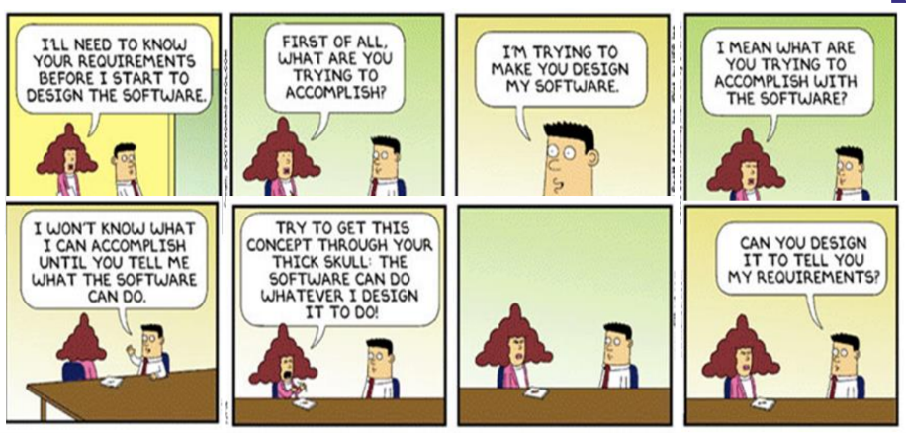
Wordplay!

Slide 6
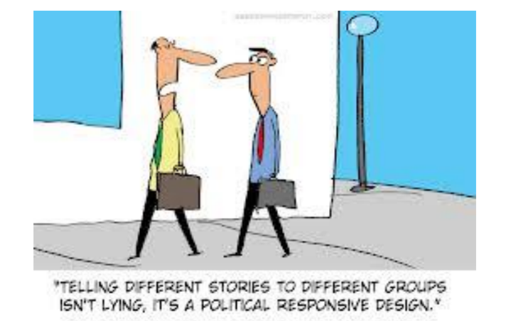
Wordplay!

Slide 7
Design Principles
Further decomposition (post architecture) of the components being developed if necessary
Description of the behavior of components/sub-systems identified as part of Architectural design
Description of how the interfaces will actually be realized using the appropriate algorithms and data structures
Description on how the system will facilitate interaction with the user through the user interface
The use of appropriate structural and behavioral design patterns & consideration of maintenance and reuse as couple of its goals

Slide 8
Techniques that Enable Design
ABSTRACTION
Focus on essential properties
TYPES OF COUPLING
TYPES OF COHESION
MODULARITY, COHESION & COUPLING
Modularity is the degree or the extent to which the larger module can be decomposed
Cohesion which is the extent to which the component/modules are dependent on/fit into or are related to each other, when trying to address a specific responsibility (Strong cohesion is good)
Coupling indicates how strongly the modules are connected to other modules.
(Loose coupling is good)
Content
Adhoc
Common
Logical
External
Temporal
Control
Sequential
Stamp
Procedural
Data
Functional

Slide 9

Think about it!
What is the type of cohesion for Input routines?
Logical
What is the type of cohesion for Initialization sequence?
Temporal
What is the type of cohesion for Read and print?
Procedural
Rank the coupling from strongest (least desirable) to weakest (most desirable):
Content Coupling - Common Coupling - External Coupling - Control Coupling - Stamp Coupling - Data Coupling Reference

Slide 10
Techniques that Enable Design
INFORMATION HIDING
Design involves a series of decisions and each such decision, need to consider who needs to know & who can be kept in the dark. This is done through:
- Encapsulation
A information hiding strategy which hides data and allows access to the data only through
specific functions
- Separation of interface and implementation
An information hiding strategy which involves defining a component by specifying a public
interface (known to the clients) but separating the details of how the component is actually
realized
LIMITING COMPLEXITY
Complexity refers to the amount of effort required for building its solution
Can be Intra – modular (within a module) or
Inter – modular (between modules)
Higher value => Higher complexity => Higher effort required (= worse design)
HIERARCHICAL STRUCTURE
Views whole structure as a hierarchy

Slide 11
Key Issues
Concurrency
Event handling
Distribution of components
Non – functional requirements
Error, Exception handling, Fault tolerance
Interaction and Presentation
Data Persistence

Slide 12
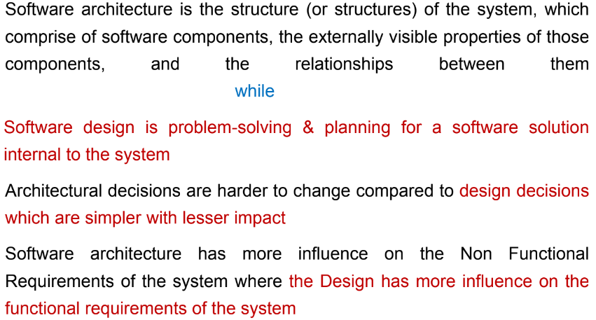
In – Class Exercise!
Provide a contrast between architecture and design

Slide 13
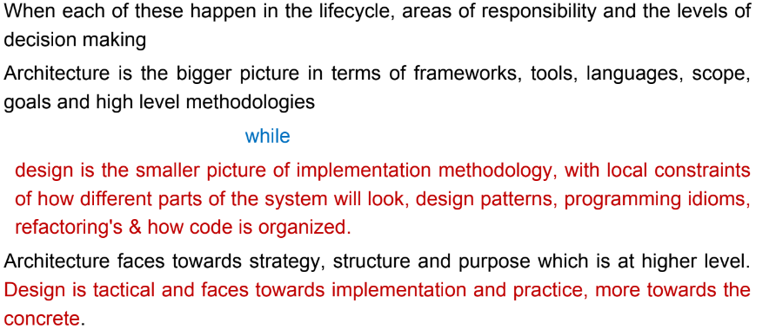
In – Class Exercise!
Provide a contrast between architecture and design

Slide 14
THANK YOU
Software Design
Department of Computer Science and Engineering
‹#›
‹#›

